Slide 2
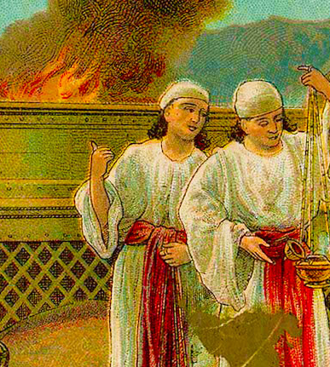
Lessons from the Fire
Leviticus 10:1-11

Slide 3
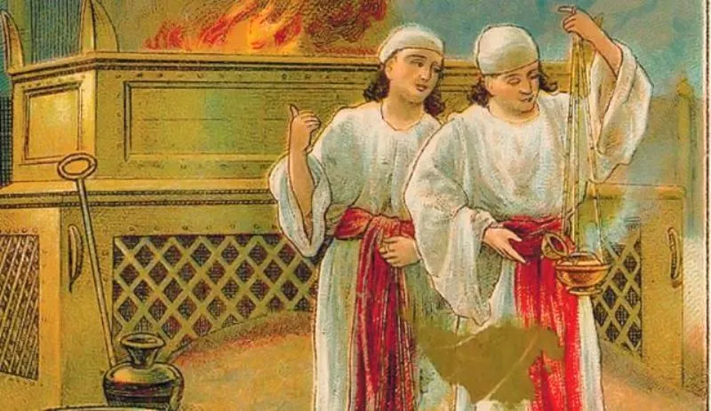
Examining The Text
Nadab and Abihu’s offering (v. 1)
Exodus 19:16-25; 24:17
Exodus 24:1-2
Exodus 24:9-11
Exodus 24:3, 7

Slide 4
Examining The Text
Nadab and Abihu’s offering (v. 1)
God’s reaction (v. 2)

Slide 5
Examining The Text
Nadab and Abihu’s offering (v. 1)
God’s reaction (v. 2)
Moses’ explanation (v. 3)
Exodus 19:22-23

Slide 6
Examining The Text
Nadab and Abihu’s offering (v. 1)
God’s reaction (v. 2)
Moses’ explanation (v. 3)
Nadab and Abihu carried out (vv. 4-5)

Slide 7
Examining The Text
Nadab and Abihu’s offering (v. 1)
God’s reaction (v. 2)
Moses’ explanation (v. 3)
Nadab and Abihu carried out (vv. 4-5)
Moses’ instructions to Aaron (vv. 6-7)

Slide 8
Examining The Text
Nadab and Abihu’s offering (v. 1)
God’s reaction (v. 2)
Moses’ explanation (v. 3)
Nadab and Abihu carried out (vv. 4-5)
Moses’ instructions to Aaron (vv. 6-7)
God’s instructions to Aaron (vv. 8-11)

Slide 9
Two Lessons
God demands we sanctify Him
1 Peter 1:14-16
1 Peter 3:15

Slide 10
Two Lessons
God is displeased with disobedience
Leviticus 16:1, 12-13

