Slide 2
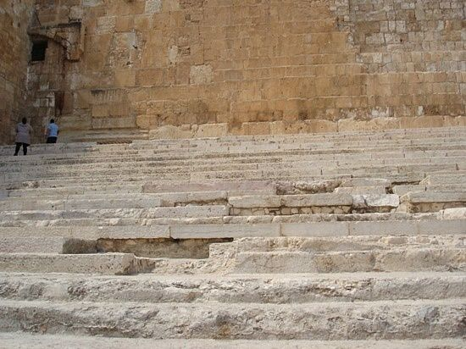
Songs of Ascents
Psalms 120-134

Slide 3
PSALM 120 Introduction
A collection of fifteen psalms from Ps. 120-134 known as…
Songs of Degrees
Songs of Ascents
Songs of the Steps
Pilgrim Psalms
Songs of Ascents

Slide 4
PSALM 120 Introduction
Israel sung these songs to prepare their minds as they traveled to the temple to worship Jehovah
Songs of Ascents

Slide 5
PSALM 120 The Pilgrim’s Prayer
The Pilgrim’s APPEAL (1-2)
Psalm 109:1-5
Songs of Ascents

Slide 6
PSALM 120 The Pilgrim’s Prayer
The Pilgrim’s APPEAL (1-2)
The Pilgrim’s ADVERSARY (3-4)
Songs of Ascents

Slide 7
PSALM 120 The Pilgrim’s Prayer
The Pilgrim’s APPEAL (1-2)
The Pilgrim’s ADVERSARY (3-4)
The Pilgrim’s AFFLICTION (5-7)
2 Peter 2:7-8
Songs of Ascents

Slide 8
PSALM 120 Seeing Myself
How do I respond to times of trouble or people who cause me trouble?
What do I learn about preparing my mind to worship God (see Matthew 5:23-26)?
Songs of Ascents

