Slide 1
2021 3rd Quarter Adult Class
The Pastoral Epistles: 1& 2 Timothy, Titus, and Philemon

Slide 2
Titus
The Crete Evangelist

Slide 3
BACKGROUND-OUTLINE
CHAPTER 1:1-4 – Salutation^^
CHAPTER 1:5-16 – Administration of Sound Doctrine (Elders and Deacons)^^
CHAPTER 2 – Preaching Sound Doctrine
CHAPTER 3 – Counseling by Sound Doctrine and Farewell
*Outline taken from “New Testament Survey” by Merrill C. Tenney
^^covered Ch. 1 alongside 1 Timothy 3

Slide 4
BACKGROUND- TITUS
Not much is known about Titus overall.
Mentioned 13 time sin the New Testament, all by Paul, but NEVER in Acts.
Some believe Titus was the brother of Luke but was just never mentioned by name.
Speculated that Titus was a convert of Paul’s (“true child after a common faith”)

Slide 5
BACKGROUND- Political Climate
Titus has been left on Crete to set in order things “wanting” from Paul’s last visit.
Also a goal to appoint Elders here at Crete.
Some threat from false teachers (same as Ephesus) in addition to relationships.
Letter written between 1 Timothy and 2 Timothy, but virtually impossible to place an exact year on the composition.

Slide 6
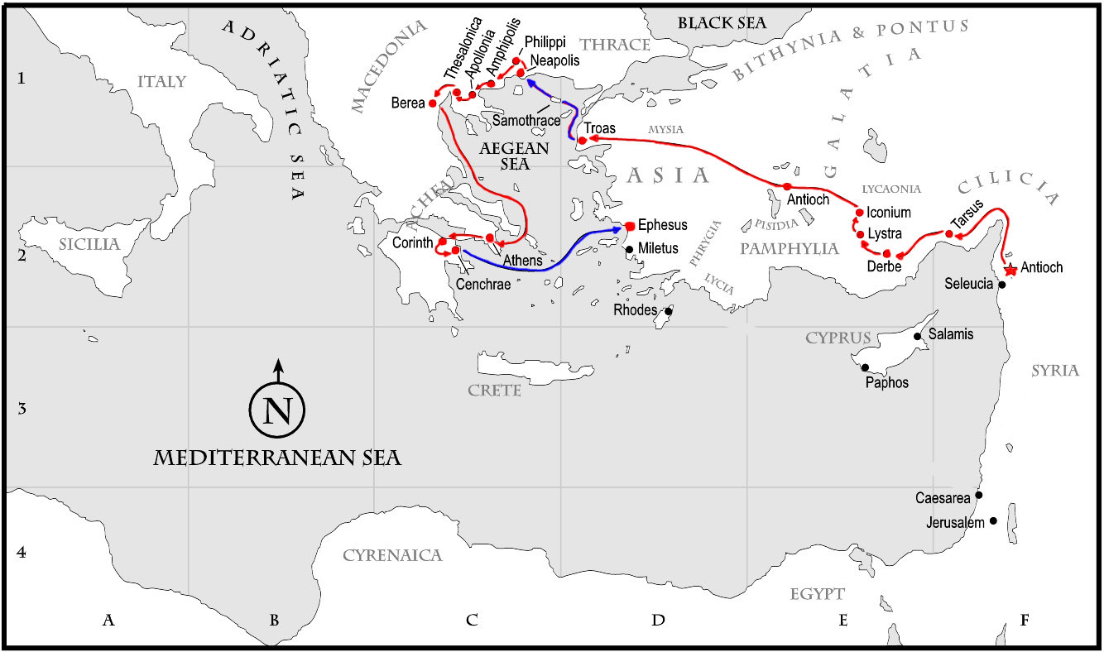
This Photo by Unknown Author is licensed under CC BY-SA

Slide 7
chapter 2
Duties of Old and Young

Slide 8
Chapter 2: 1-5
Chapter 1 ended with Paul warning Titus about the false teachers rampant around Crete at the time.
Chapter 2 begins with “But as for you…” indicating a contrast of thinking.
Older men and women (Greek words indicate someone in their 50s-60s) are to be instructed to be role models for the younger generations.
Why is it fitting for those who fit the qualifications of the term “older” to instruct and teach the younger? Can this still be applied today?
Notes:
Go through specific things Titus was to instruct them in:
-temperate [nephalios]: moderation
-grave [semnos]: dignified/serious
-sober minded/sensible: same conotations as 1 Tim. 3:2
-sound in faith: 1:13
-healthy faith

Slide 9
Chapter 2: 6-8
Younger generations are now contrasted to the older from vs. 1-5
Titus is called to “exhort” them (vs. 6) and follow the same guidelines (vs. 7-8)
Why would these verses be so important for younger men/women to adhere to? (think 1 Timothy 3)

Slide 10
Chapter 2: 9-10
The relationship of Master/Servant was VERY sensitive in the early church because of the time period (common type of thing)
Addressed by Paul in 1 Timothy as well as Titus
Paul urges Titus to have the slaves remember their relationship to their masters, but also remember that they are children of God and are to exhibit him in all they say and do.
How can we today use these instructions in our own lives? Obviously we have all been taught slavery is bad, but are there still principles here we can adapt?

Slide 11
Chapter 2: 11-15
Verses 11-14 refer to a “grace of God” that brough salvation to all men. Describe how this grace came about and how it impacts us today.
Verse 15 is an instruction to Titus (and by extension today us) to “speak and exhort and reprove with all authority” the things mentioned prior to the verse. Why is that so important for us today?

