Slide 2
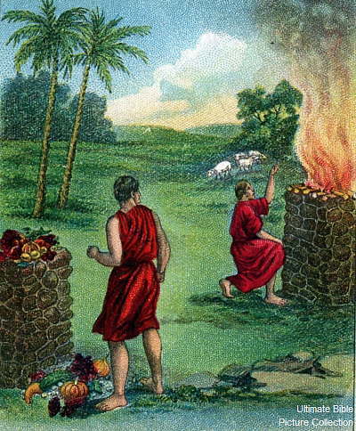
CAIN: Learning Lessons about Sin
Genesis 4:7

Slide 3
CAIN: Learning Lessons about Sin
Choices Are Critical
“If you do well…if you do not do well”
Ezekiel 18:5-13
Ezekiel 18:21-23

Slide 4
CAIN: Learning Lessons about Sin
Sin Is Close By
“Sin is crouching at the door”
1 Peter 5:8
Ephesians 4:26-27

Slide 5
CAIN: Learning Lessons about Sin
Sin Wants to be Your Master
“Its desire is for you”
Romans 6:12-16

Slide 6
CAIN: Learning Lessons about Sin
You Must Master Sin
“You must master it”
Ephesians 6:10-11
James 4:7
1 Peter 5:9
1 Corinthians 10:13
Hebrews 12:1-3

