Slide 2
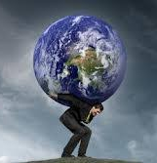
Overcoming the World
John 16:29-33

Slide 3
Having Peace in Jesus
Matthew 10:34
John 14:27
1 John 4:15-5:5

Slide 4
Overcoming Tribulation
1 John 2:13-14
1 John 4:1-6

Slide 5
Taking Courage in Christ’s Victory
Revelation 5:1-5
Revelation 12:7-12
Revelation 2:7, 11, 17, 26; 3:5, 12, 21

