Slide 2
OR
Galatians 5:13-26

Slide 3
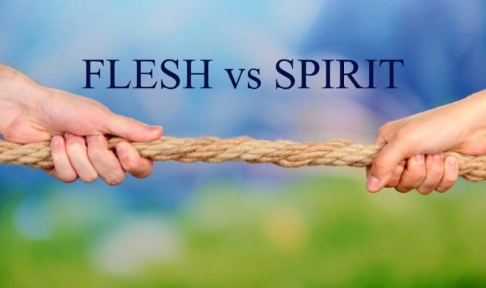
Divisive, Self-Centered Sins
Enmities
Hatred, hostility, opposition
An inner attitude that results in treating others as enemies

Slide 4
Divisive, Self-Centered Sins
Strife
Enmity in action
Discord, contention, quarreling, fighting

Slide 5
Divisive, Self-Centered Sins
Jealousy
Zeal, fervor, excitement
“An envious and contentious rivalry” (Thayer’s)
Resentment for what others possess that you don’t

Slide 6
Divisive, Self-Centered Sins
Outbursts of anger
“Passion (as if breathing hard)” – Strong’s
“It signifies both the spirit panting as it were in the body, and the rage with which the man pants and swells” – Thayer’s
An angry heat that quickly explodes and soon subsides

Slide 7
Divisive, Self-Centered Sins
Disputes
Strife
A selfish, self-seeking, partisan, factious spirit
Putting personal ambition and party loyalty above what is right and/or good for others

Slide 8
Divisive, Self-Centered Sins
Dissensions
Division; disunity
Selfish, partisan spirit in action

Slide 9
Divisive, Self-Centered Sins
Factions
From a Greek word meaning, “choice or preference”, it came to mean a group of people holding to the same belief and rallying around that belief
Complete separation or division

Slide 10
Divisive, Self-Centered Sins
Envying
Ill-will or malice toward others
It often results in wanting what others possess so badly that one maligns, attacks, destroys them

Slide 11
Examining Similar Biblical Texts
Proverbs 6:12-19; 16:27-28
Worthless, wicked, perverse people
Individuals that spread strife, and split close friends, family, brethren by their words and innuendo
The Lord not only hates these sins, but abhors, destests them!
Those who practice such sins suffer ruin!

Slide 12
Examining Similar Biblical Texts
Proverbs 15:1, 18; 26:20-22
Harsh, hot-tempered, contentious, gossips
These people stir up strife and/or keep it going
We must be calm, gentle, patient, “slow to anger” people who put out fires, and “turn away from wrath” with our words and demeanor

Slide 13
Examining Similar Biblical Texts
Ephesians 4:26-27, 29-31; Colossians 3:8
If these sins were a part of us before becoming Christians, we must put them away when they rear their ugly heads
We must replace them with wholesome, edifying, gracious words!
Anger isn’t necessarily a sin; but we must get it under control so that the devil doesn’t live in us

Slide 14
Examining Similar Biblical Texts
1 Timothy 6:3-5
If we’re consumed with constant controversy, and keep it stirred up, it will result in some of the divisive sins of Gal. 5:20-21

Slide 15
Examining Similar Biblical Texts
James 3:13-16
Jealousy and strife are from Satan
They produce “disorder and every evil thing”

Slide 16
Examples In Our World
Rumors
Name-calling
Slander
Innuendo
Lies
War of words
Physical violence

Slide 17
Examples In Our World
Road rage
Theft
Destroying property
Political/religious “parties”

Slide 18
Examples In Our World
These are seen in…
Politics
Protests/riots
Family fights
Arguments, splits, “party” spirit, division among brethren
Materialism

Slide 19
Examples In Our World
These are seen in…
Social media
Media
Workplace
School
Sporting events

