Slide 2
“Most Americans believe in heaven…and hell” (Pew Research)
GROUP | HEAVEN | HELL
U.S. Adults | 72% | 58%
“Religiously affiliated” | 82% | 67%
“Christian” | 85% | 70%
- Protestant | 86% | 75%
- Evangelical | 88% | 82%
- Mainline | 80% | 60%
* In 2007, 74% of U.S. adults believed in heaven, 59% in hell *

Slide 3
Belief of Americans in heaven and hell (Statista Research Dept.)
ANSWER | HEAVEN | HELL
YES | 71% | 64%
NO | 15% | 22%
NOT SURE | 14% | 13%
* In 2011, about 75% of respondents believed in hell *

Slide 4
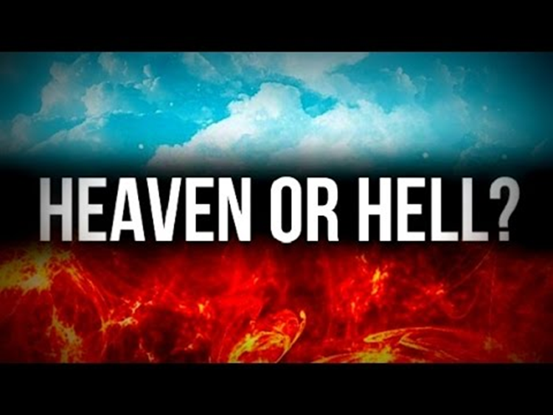

Slide 5
What does hell mean?
In NASU and ESV, hell appears 13/14 times
NKJ has 32 references; KJV has 54
From Hebrew Geena or Gehenna, a reference to the valley of Ben-Hinnom
2 Chronicles 28:1-3; 33:1-6
Jeremiah 7:27-33; 19:4-7

Slide 6
What does hell mean?
“The place (or state) of everlasting punishment” (Strong’s)
Hell is an eternal wasteland, a realm of eternal torture, punishment and separation from God and all that is good!

Slide 7
Why does hell exist?
Matthew 25:41
2 Peter 2:4
Jude 6

Slide 8
What is hell like?
Matthew 8:10-12
Matthew 13:40-42, 49-50
Mark 9:42-48
2 Thessalonians 1:9
Revelation 20:10-14

