Slide 2
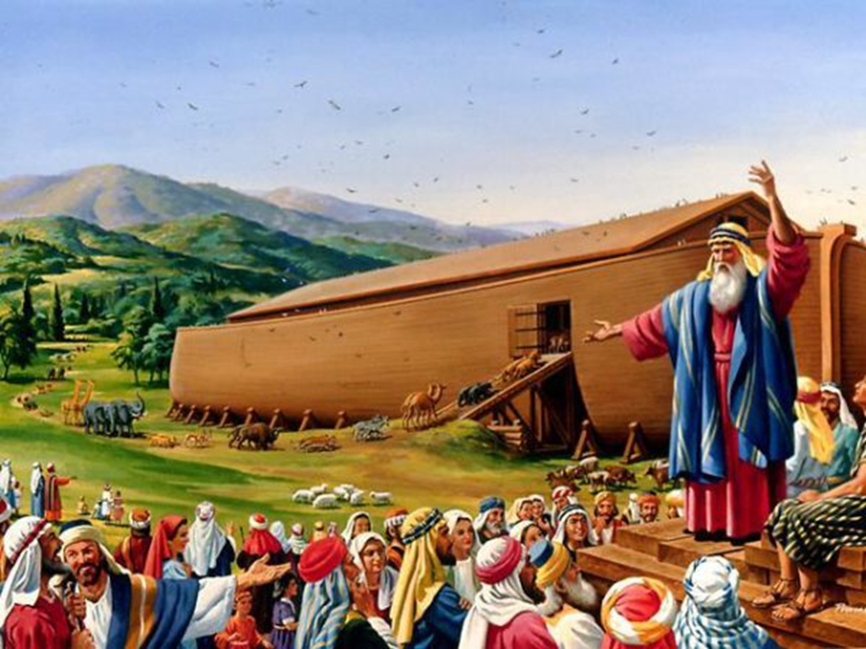
Noah: Righteous In an Unrighteous World

Slide 3
Noah’s World
Genesis 6:5-7, 11-13
Genesis 1:26-27
Ephesians 4:17-19
NOAH:
Righteous In an Unrighteous World

Slide 4
Noah’s Character and Life
Found favor in the Lord’s eyes (Genesis 6:8)
NOAH:
Righteous In an Unrighteous World

Slide 5
Noah’s Character and Life
Found favor in the Lord’s eyes (Genesis 6:8)
Righteous (Genesis 6:9)
Genesis 7:1
Ezekiel 14:13-20
NOAH:
Righteous In an Unrighteous World

Slide 6
Noah’s Character and Life
Found favor in the Lord’s eyes (Genesis 6:8)
Righteous (Genesis 6:9)
Blameless (Genesis 6:9)
NOAH:
Righteous In an Unrighteous World

Slide 7
Noah’s Character and Life
Found favor in the Lord’s eyes (Genesis 6:8)
Righteous (Genesis 6:9)
Blameless (Genesis 6:9)
Walked with God (Genesis 6:9)
Genesis 5:24
Genesis 6:17-18
NOAH:
Righteous In an Unrighteous World

Slide 8
Noah’s Character and Life
Found favor in the Lord’s eyes (Genesis 6:8)
Righteous (Genesis 6:9)
Blameless (Genesis 6:9)
Walked with God (Genesis 6:9)
Obedient (Genesis 6:22; 7:5)
Genesis 6:14-16; 7:2-3
NOAH:
Righteous In an Unrighteous World

Slide 9
Noah’s Character and Life
Found favor in the Lord’s eyes (Genesis 6:8)
Righteous (Genesis 6:9)
Blameless (Genesis 6:9)
Walked with God (Genesis 6:9)
Obedient (Genesis 6:22; 7:5)
Great faith (Hebrews 11:7)
NOAH:
Righteous In an Unrighteous World

Slide 10
Two Truths to Remember
Righteousness can exist in our unrighteous world
2 Peter 2:5
Philippians 2:14-16
Titus 2:11-14
NOAH:
Righteous In an Unrighteous World

Slide 11
Two Truths to Remember
Righteousness can exist in our unrighteous world
God preserves His people and punishes His enemies
2 Peter 2:5, 9-10
NOAH:
Righteous In an Unrighteous World

