Slide 2
Instrumental Music in Worship

Slide 3
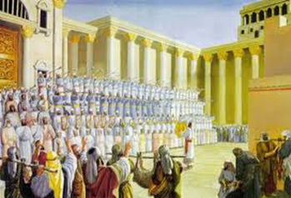
Instrumental Music in O.T. Worship
Psalm 150
2 Chronicles 5:11-14
2 Chronicles 29:25-28

Slide 4
Instrumental Music in O.T. Worship
Do these texts give us authority to use instrumental music in worship today?
Hebrews 10:1-9

Slide 5
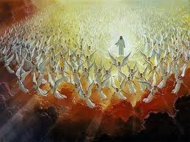
Instrumental Music in Heavenly Worship
Revelation 5:8-10
Revelation 14:1-3
Revelation 15:2-4

Slide 6
Instrumental Music in Heavenly Worship
Do these texts give us authority to use instrumental music in worship today?

Slide 7
Instrumental Music in Heavenly Worship
Two Facts about Revelation…
It uses highly symbolic language (1:1)
Heaven is a spiritual realm, not a physical place

Slide 8
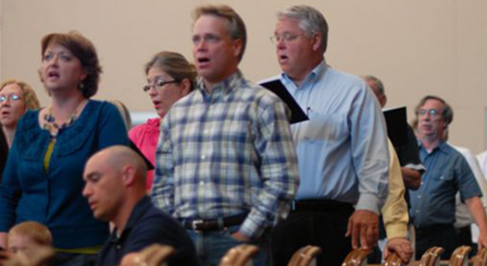
Music in N.T. Worship
Ephesians 5:15-21
Colossians 3:15-17

Slide 9
Music in N.T. Worship
Do these texts give us authority to use instrumental music in worship?
Does using instruments fundamentally change the type of music we’re offering to God?
God commanded their use in O.T. worship, but not in N.T. worship!

