Slide 2
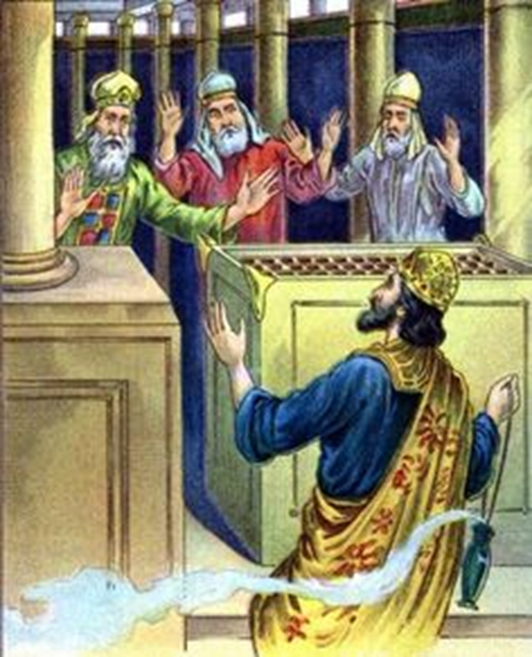
UZZIAH: Lessons from a King
2 Chronicles 26

Slide 3
God blesses those that seek Him
James 4:8
2 Chronicles 14:7; 15:1-2, 15
Hebrews 11:6
UZZIAH
Lessons from a King

Slide 4
Pride pulls us away from God
Proverbs 16:18
UZZIAH
Lessons from a King

Slide 5
Pride pulls us away from God
Personal pride in Bible knowledge, spiritual strength, maturity level
1 Corinthians 10:11-12
UZZIAH
Lessons from a King

Slide 6
Pride pulls us away from God
Congregational pride in being “sound in the faith”, large numbers, being an active church, the number of preachers we support
Revelation 3:17-19
UZZIAH
Lessons from a King

Slide 7
Pride pulls us away from God
National pride in military might, financial power, technological superiority
Proverbs 14:34
Deuteronomy 32:15-18
UZZIAH
Lessons from a King

Slide 8
God punishes those that don’t seek Him
Uzziah’s failure and success were directly tied to whether he sought the Lord or not!
2 Thessalonians 1:8-9
UZZIAH
Lessons from a King

