Slide 2
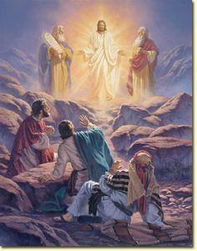
The Transfiguration of Jesus
Matthew 17:1-13

Slide 3
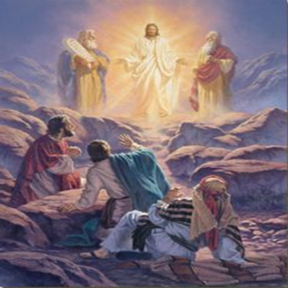
SIX EVENTS
Jesus took His “inner circle” up on a mountain, where He prayed
Matthew 17:1
Mark 5:37
Mark 14:33

Slide 4
SIX EVENTS
Jesus took His “inner circle” up on a mountain, where He prayed
Matthew 17:1
Luke 9:28-29
Luke 3:21
Luke 6:12
Luke 22:41

Slide 5
SIX EVENTS
Jesus was transfigured
Matthew 17:2
Mark 9:3
Luke 9:29

Slide 6
SIX EVENTS
Moses and Elijah appeared and talked to Jesus
Matthew 17:3
Luke 9:30-31

Slide 7
SIX EVENTS
Moses and Elijah appeared and talked to Jesus
Matthew 17:3
Why Moses and Elijah?
They were two of the most highly-respected Jews
They represented “the law and the prophets”

Slide 8
SIX EVENTS
Peter proposed making three tabernacles
Matthew 17:4
Mark 9:6
Luke 9:33

Slide 9
SIX EVENTS
God spoke
Matthew 17:5
Luke 9:35
“Hear Him!”

Slide 10
SIX EVENTS
Jesus ordered these apostles to remain silent
Matthew 17:9
2 Peter 1:16-18
1 John 1:1-3

Slide 11
ITS SIGNIFICANCE
It proves Jesus is THE Christ!
Matthew 16:16
John 20:30-31

Slide 12
ITS SIGNIFICANCE
It proves Jesus is THE Christ!
It proves Jesus is supreme!
Hebrews 1:1-2

