Slide 2
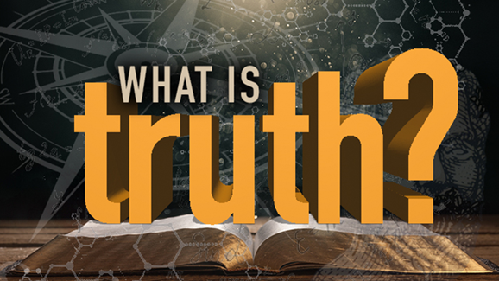
What Is Truth?
JOHN 18:38

Slide 3
Jesus Christ is truth
John 1:14, 17
John 14:6
John 18:37
The Jewish leaders didn’t speak truth (John 18:30; Luke 23:2)
They weren’t interested in truth; they weren’t truthful (John 8:44-45)

Slide 4
Jesus Christ is truth
Do we hear Him when He says…
“Unless you believe that I am, you will die in your sins” (John 8:24)?
“He who has believed and has been baptized shall be saved” (Mark 16:16)?
“Love the Lord your God with all your heart, soul, mind and strength; and your neighbor as yourself” (Mark 12:30-31)?

Slide 5
God’s word is truth
John 17:14-19
Psalm 119:160
John 8:31-36
John 16:13

Slide 6
God’s word is truth
Do we know what God’s word says about…
God?
Satan?
Creation?
Sin?
Salvation?
The church?
Family?
Daily living?
Heaven and hell?

