Slide 2
Puerto Rico
2019

Slide 3
The island
100 miles long
30 miles wide
3.5 million people
1.5 million in San juan
All but a few basic products are shipped in to the country
Two churches on the island: San juan and san sabastian

Slide 5
The countryside

Slide 6
The countryside

Slide 7
The countryside

Slide 8
The countryside

Slide 9
San Juan

Slide 10
San Juan

Slide 11
San Juan

Slide 12
San Juan

Slide 13
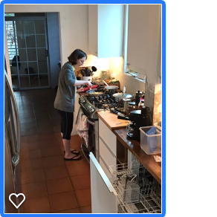
Joel Holt Anna Tabitha

Slide 14
Caleb Westbrook

Slide 15
The church in San Juan

Slide 16
The church in San Juan

Slide 17
The church in San Juan

Slide 18
The church in San Juan

Slide 19
The church in San Juan

Slide 20
The church in San Juan

Slide 21
The church in San Juan

Slide 22
The church in San Juan

Slide 23
The church in San Juan

Slide 24
The church in San Juan

Slide 25
The church in San Juan

Slide 26
The church in Venezuela

Slide 27
The church in San Juan

