Slide 2
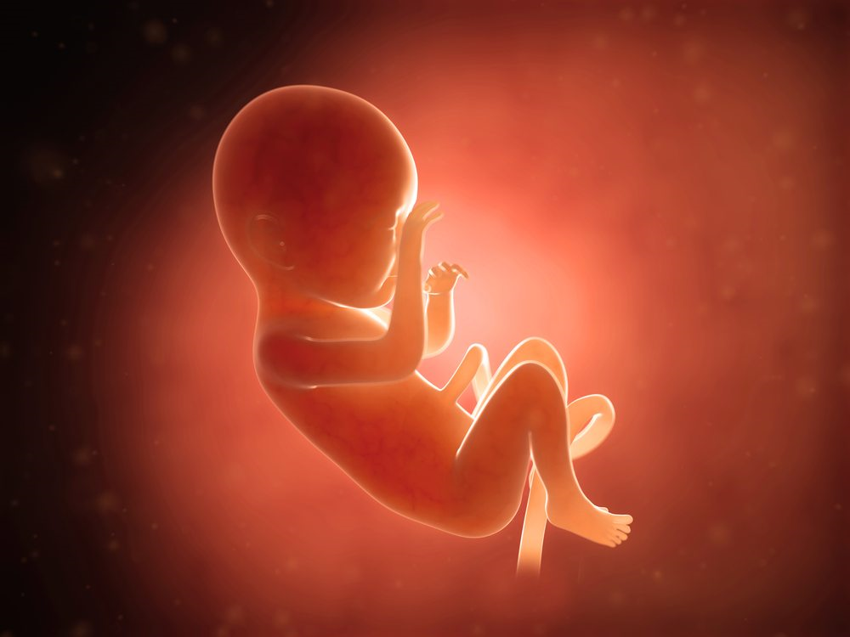
ABORTION
How We Respond

Slide 3
Two Christ-like Responses
Teach the Truth in Love
Acts 17:17
Luke 9:51-56
John 4:7, 16-18
John 8:10-11
Luke 19:10
Luke 5:32

Slide 4
Two Christ-like Responses
Teach the Truth in Love
Ephesians 6:4
Titus 1:9
2 Timothy 4:2-4

Slide 5
Two Christ-like Responses
Pray, Pray, Pray!
Ezra 9:5-15
Daniel 9:4-19
1 Timothy 2:1-2
1 Timothy 2:3-4
Romans 10:1
2 Peter 3:9

